Slide 1
Regression with Categorial X Variables
Dr. Junbum Kwon
22 Feb 2019

Slide 2
Content
Linear regression with
Continuous variable X
Category (or Dummy) variable with 2 categories
(e.g. Male / Female)
Category variable with 3 categories
Reference: John Fox’s Dummy-Variable Regression

Slide 3
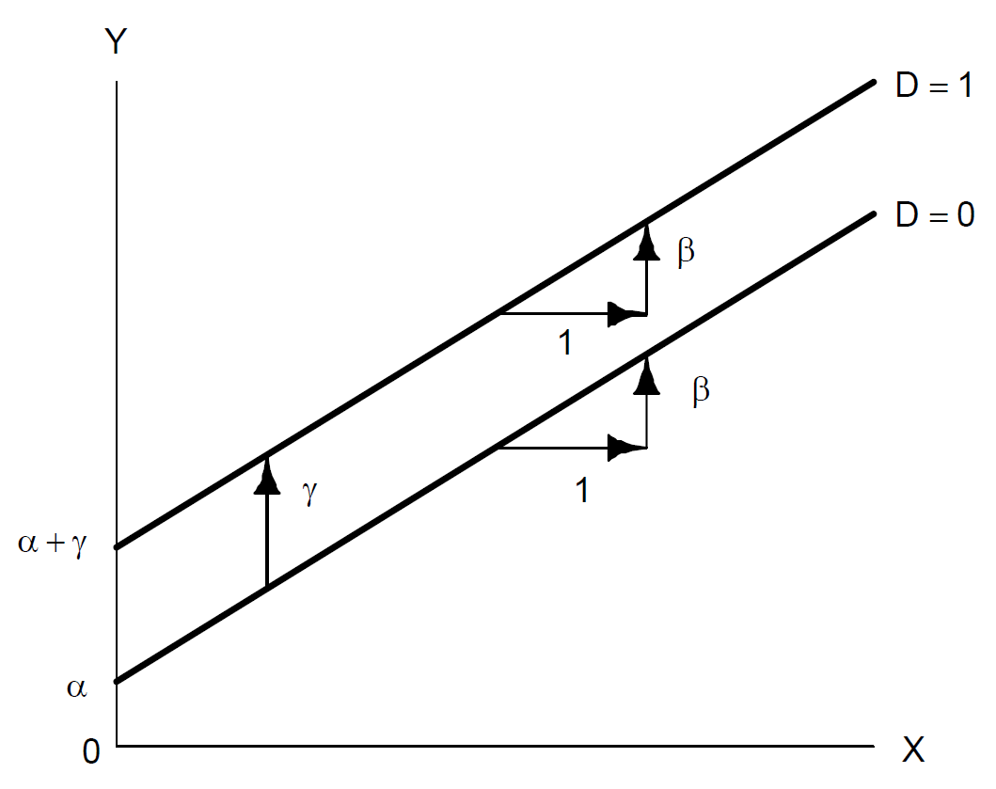
Category variable with 2 categories
Income
Men
Question:
Average income difference b/w men and women?
Women
Education Years

Slide 4

Category variable with 2 categories
Question:
Average income difference b/w men and women?
Income
Men
Women
Answer: $γ$

Slide 5
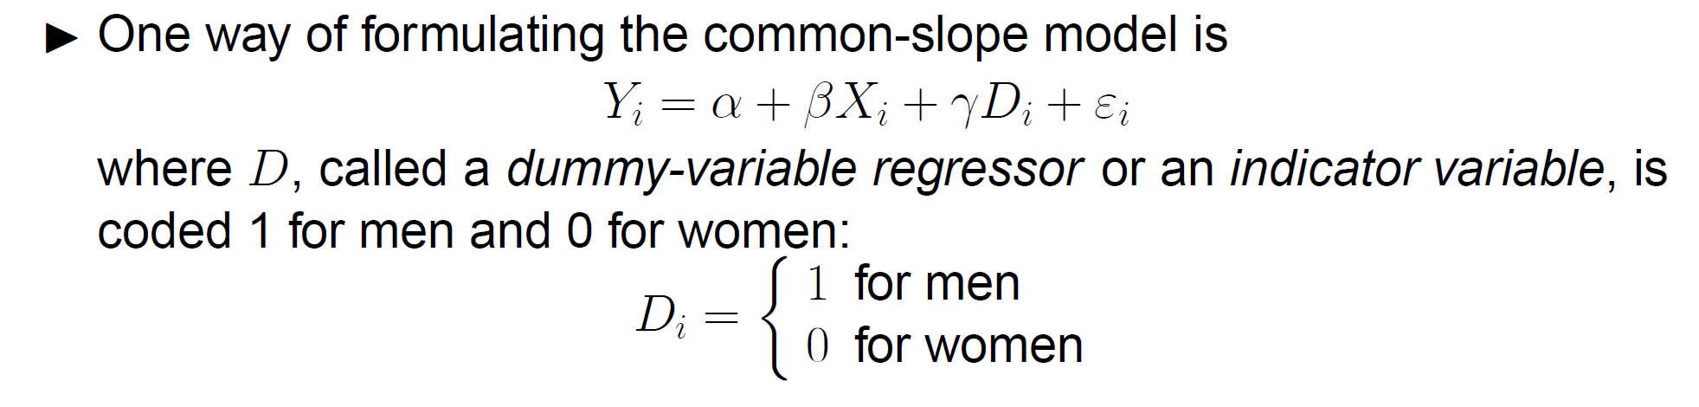
Category variable with 2 categories
(“Women” is a baseline)

Slide 7

Category variable with 2 categories
Difference = $γ$

Slide 8
Interpretation

Slide 9
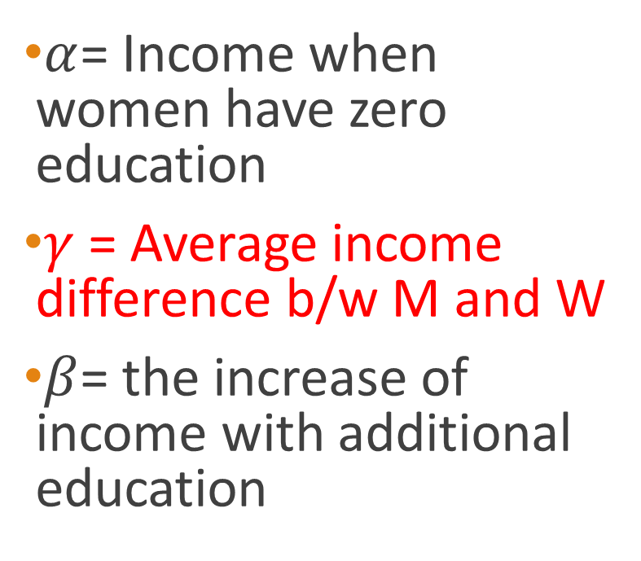
Interpretation
$α$= Income when women have zero education
$γ$= Average income difference b/w M and W
$β$= the increase of income with additional education
Income
Men
Women
Education

Slide 10
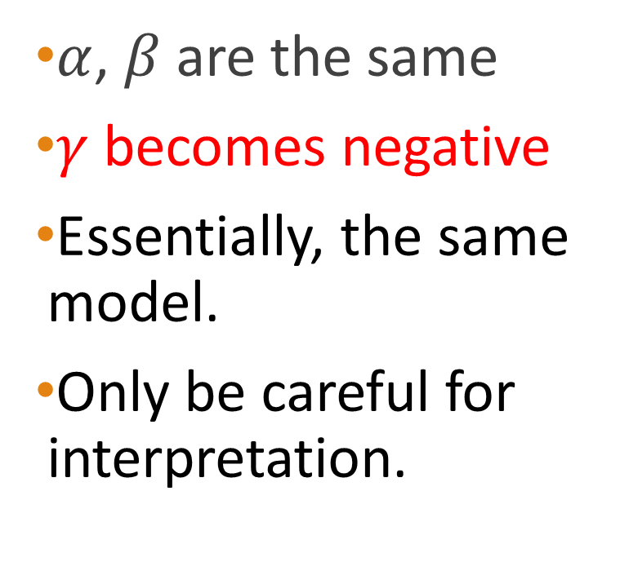
What if Men (D=0), Women (D=1)?
(Now, “Men” is a baseline)
Income
Men
$α$, $β$are the same
$γ$ becomes negative
Essentially, the same model.
Only be careful for interpretation.
Women
Education

Slide 11
Category variable with 3 categories
1 dummy variable for 2 categories (e.g. Male, Female)
How many dummy variables do we need for 3 categories (e.g. Blue Collar, White Collar, or Professional)?

Slide 12
Category variable with 3 categories
Remember Baseline for correct interpretation

Slide 14
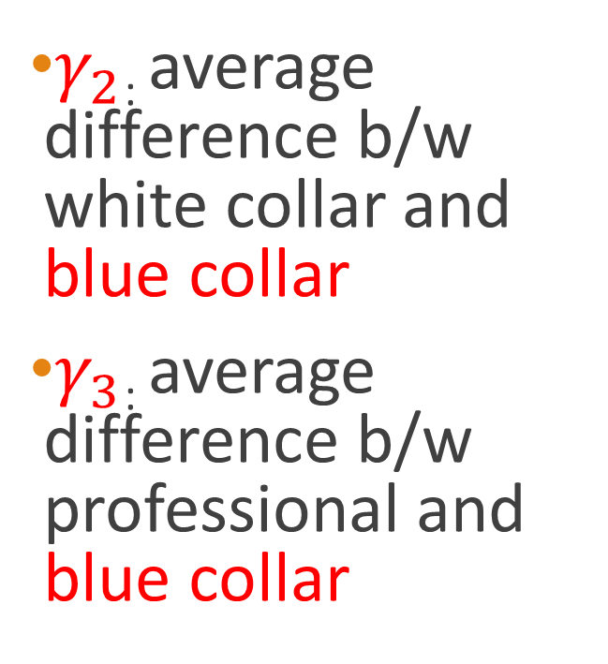
Category variable with 3 categories
$γ_{2}$: average difference b/w white collar and blue collar
$γ_{3}$: average difference b/w professional and blue collar
Education
Professional
White Collar
Blue Collar
Income

